Slide 1







Identifying Risk Factors in Severe Traffic Accidents
A Data-Driven Analysis of UK Road Safety (2024)
Tiago De Oliveira Freitas
Student Number: 2021406
Institution: CCT College Dublin
Module: Data Exploration & Preparation
2024 DATA
Research Question
What factors are most correlated with severe accidents in Great Britain?
Motivation:
Traffic accidents cause over 3,000 deaths annually in the UK.
Understanding severity factors can inform targeted safety interventions and save
lives.
GitHub Repository: [Your GitHub Link]

Slide 2





Dataset and Methodology
Data Source
Methodology Overview
1
Data cleaning and preparation (handling missing values, outliers)
Source:
UK Department for Transport
Dataset:
Road Safety Open Data (2024)
2
Exploratory Data Analysis (EDA) with statistical tests
System:
STATS19 collision reporting
3
Feature encoding (Label and One-Hot)
License:
Open Government Licence
4
Principal Component Analysis (PCA) for dimensionality reduction
Dataset Characteristics
Severity Classification
Original records:
100,927 collisions
Fatal
Serious
Cleaned records:
26,516 collisions
176
4,825
Features:
19 selected from 44 available
0.66%
18.20%
Coverage:
Great Britain, full year 2024
Slight
Total Severe
21,515
5,001
81.14%
18.86%
for clearer risk factor analysis
Binary target variable created: is_severe (0=Slight, 1=Severe)

Slide 3





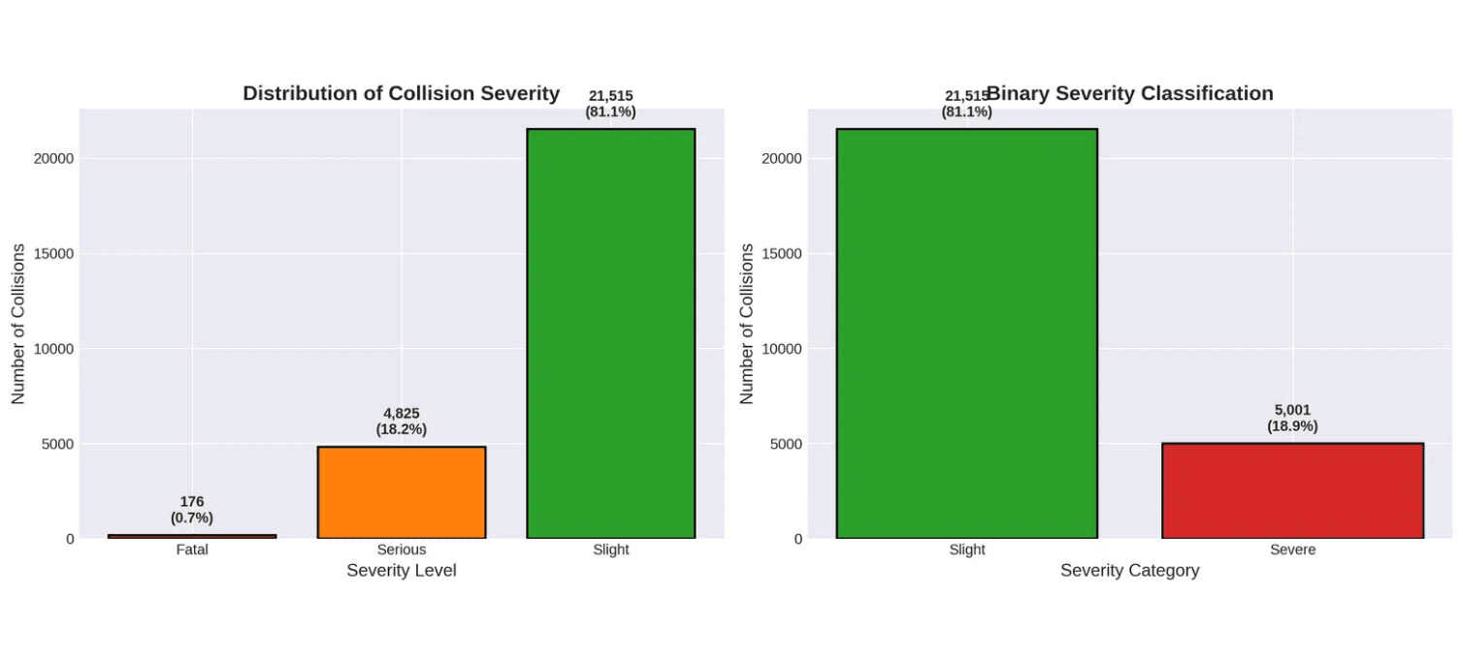



Data Preparation Challenges
Challenge 1: Missing and Invalid Data
Data Quality Metrics
Dataset uses code -1 for unknown/invalid values found in 9 columns with varying percentages.
Missing Values
0
Solution:
Removed rows with -1 in critical columns (junction_detail, junction_control,
Duplicate Records
0
special_conditions_at_site).
Result:
Features Selected
19
Reduced from 100,927 to 26,516 rows while maintaining data quality.
Final Records
26,516
Challenge 2: Imbalanced Severity Distribution
Only 18.86% of accidents are severe (Fatal + Serious).
Solution:
Created binary target variable: is_severe (0=Slight, 1=Severe).
Result:
Enables clearer analysis of risk factors.
Feature Engineering
• Created is_weekend indicator (Saturday/Sunday)
• Categorized speed limits into Low/Medium/High/Very High
• Standardized all numerical features for PCA

Slide 4


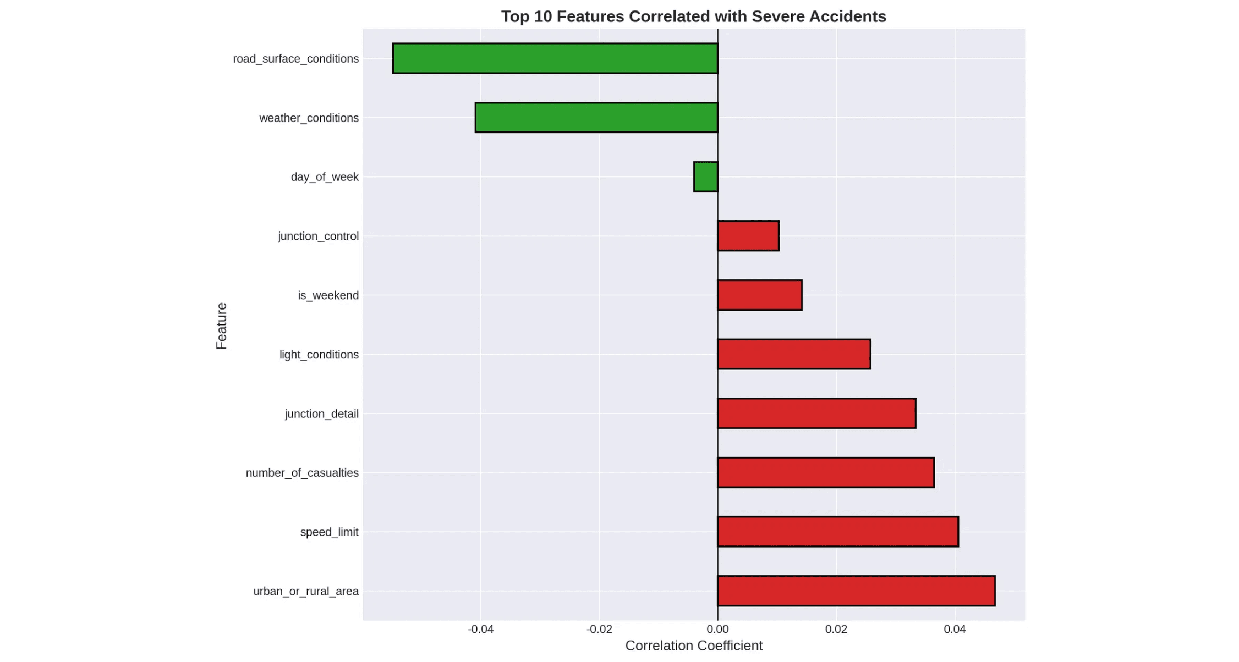


Exploratory Data Analysis - Key Findings
Correlation Analysis
Positive Correlations (Increase Severity)
Urban/Rural Area
+0.047
Speed Limit
+0.041
Number of Casualties
+0.037
Junction Detail
+0.033
Light Conditions
+0.026
Negative Correlations (Decrease Severity)
Number of Vehicles
-0.079
Unusual Pattern Discovered
Road Surface Conditions
-0.055
Accidents with fewer vehicles are MORE severe (negative correlation of -0.079). This counterintuitive finding suggests single-vehicle accidents are more deadly than multi-vehicle collisions.
Weather Conditions
-0.041
Statistical Significance (Chi-Square Tests)
Hypothesis: Single-vehicle accidents at high speeds (e.g., rural roads) are more deadly than multi-vehicle urban collisions where speeds are typically lower.
Weather Conditions: χ² = 71.78, p < 0.001 ***
Key Takeaway
Light Conditions: χ² = 43.66, p < 0.001 ***
All tested factors are statistically significant (p < 0.05), confirming their relationship with accident severity. Rural areas and high speed limits are the strongest predictors of severe accidents.
Road Surface: χ² = 91.59, p < 0.001 ***
Urban/Rural: χ² = 58.48, p < 0.001 ***
Weekend: χ² = 5.26, p = 0.022 *

Slide 5




Encoding and PCA Implementation
Encoding Schemes
PCA Results
1. Label Encoding
Dimensionality Reduction
Features:
17 features encoded
17
13
91.76%
Method:
Numerical codes maintained
Original Features
PCA Components
Variance Retained
Use case:
Tree-based models
Advantage:
Preserves ordinal relationships
Reduction:
23.53% dimensionality decrease
Information loss:
Only 8.24%
2. One-Hot Encoding
Standardization:
StandardScaler (mean=0, std=1)
Input:
14 categorical features
Principal Component Interpretation
Output:
88 binary features
PC1 (17.51% variance)
Expansion:
17 → 88 features (+418%)
Road and environmental hazards (carriageway, surface, weather)
Use case:
Linear models, neural networks
PC2 (10.90% variance)
5.2×
Road characteristics and location (speed limit, urban/rural)
PC3 (8.52% variance)
Feature Expansion Ratio
Road type and traffic control (road type, junction control)

Slide 6









Conclusions and Implications
Key Research Findings
Methodological Contributions
1. Rural Areas
2. High Speed Limits
PCA Effectiveness: Achieved 91.76% variance retention with 23.53% dimensionality reduction (17 → 13 components)
+4.7%
+4.1%
Higher correlation with severity due to high speeds and less infrastructure
Direct relationship: speed ↑ = severity ↑
Statistical Validation: All risk factors statistically significant (p < 0.05)
3. Poor Lighting
4. Junction Type
Reproducible Pipeline: Complete analysis workflow from data cleaning to PCA
+2.6%
+3.3%
Limitations
Darkness impairs visibility and reaction time
Certain designs increase collision risk
Dataset limited to 2024 (temporal generalization unknown)
▸
Some features excluded due to missing data
Policy Implications
▸
Binary severity classification may oversimplify Fatal vs. Serious distinction
▸
Prioritize speed enforcement in rural areas with targeted campaigns
Future Research Directions
Temporal analysis across multiple years
Invest in road lighting infrastructure, especially on rural routes
▸
Machine learning models for severity prediction
Redesign high-risk junctions with improved control mechanisms
▸
Geographic clustering analysis
▸
Target safety campaigns to rural drivers about speed risks
Integration with vehicle telematics data
▸
References
[1] Department for Transport. (2025). Road safety open data. GOV.UK. https://www.gov.uk/government/statistical-data-sets/road-safety-open-data

